Slide 1
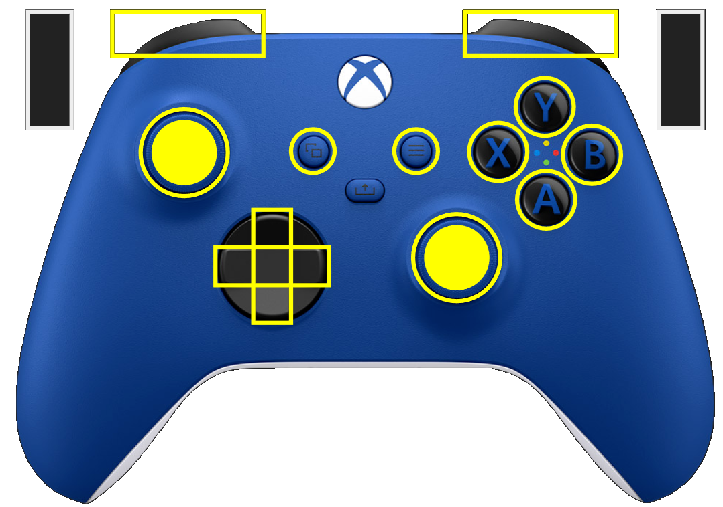
Driver
Approach Depot
Left Bump Drive
Right Bump Drive
Approach Coral
Retract Climber
Empty Fuel
Goto Climb
Brake
Extend Climber
Reset Position
Get Off Fuel
Aim & Shoot
Just Shoot
Intake Fuel
Override
Bumper
Bumper
Face Ladder
Trigger
Trigger
Auto Climb
Field Position
Straif Hub R -> L
Straif Hub L->R
Rotation

Slide 2
